Slide 1
ALGEBRA 4
Day 44

Slide 2

Bell Work
Solve
$$1.) x^{2}−2x=35$$

Slide 3
From Last Time
Finish: Page 245 #12– 20 (even)
Page 253 #41, 42

Slide 4
5.1 Polynomial Functions
Objective: To classify Polynomials.
To Use the of Graph Polynomial Functions to Describe End Behavior.

Slide 5
Identifying Polynomials:
Polynomial: f(x) = a_{n}x^{n} + a_{n-1}x^{n-1} + … + a₁x + a₀, where a_{n} ≠ 0,
Exponents are all whole numbers, and coefficients are all real numbers
Leading Coefficient = a_{n}
Constant Term = a₀
Degree = n
Standard Form: when terms are written in descending order of exponents from left to right

Slide 6
End Behavior: the behavior of the graph as x approaches positive and negative infinities x → + ∞ is read as “x approaches positive infinity”

Slide 7
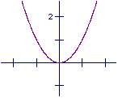
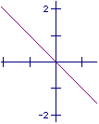
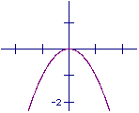
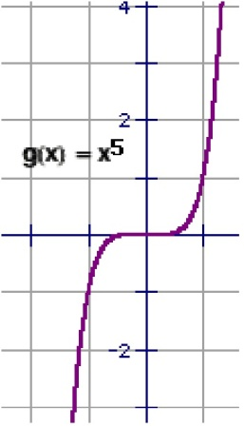
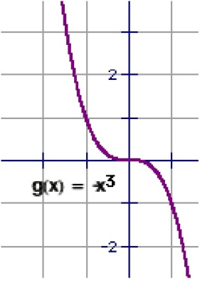
f(x) = x⁵ + 2x² - x + 4
f(x) = 2 + x² – x⁴

Slide 8
Example: f(x) = 6x–3x³ + x + 7x² – 10 + 5x⁴
Standard Form:
Lead Coefficient:
Constant:
Degree:
End Behavior:

Slide 9
Decide whether the function is a polynomial function. If it is, write the function in standard form and state the degree, type and leading coefficient.
f(x) = 12 – 5x f(x) = x – 3x⁻² – 2x³
f(x) = 36x² – x³ + x⁴ f(x) = x + π

Slide 10
For Next Time
page 285 #3-5, 9-27 (odd), 39, 43, 48
***For 9–27 and 43 change directions to:
Write in Standard Form, Identify the Degree, Lead Coefficient, Constant, and End Behavior

